Slide 1

Concept 2 – Dynamic Dispatch and Non-Polymorphism
INSEARCH CRICOS provider code: 00859D I UTS CRICOS provider code: 00099F Insearch Limited is a controlled entity of the University of Technology Sydney (UTS), and a registered private higher education provider of pathways to UTS.

Slide 2
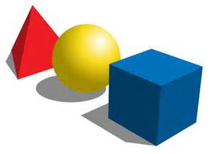
Another Example of Polymorphism
Consider a rectangle, a triangle and a circle.
They are all shapes
They all have a perimeter and an area
But the area and perimeter are calculated differently for each shape
Can we call the same methods on each shape?
area() ? perimeter() ?
Will the method behave differently for each shape?
Is this Polymorphism?

Slide 3
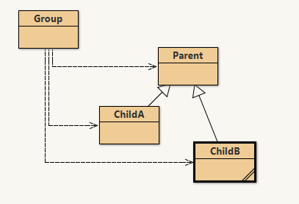
Polymorphism Pattern

Slide 4
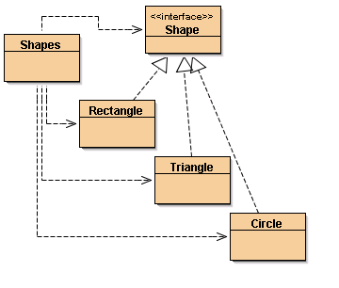
Polymorphism Example

Slide 5
Shapes Implementation
See Shapes Polymorphism Code
Triangle, Rectangle and Circle all inherit from Shape interface
All supply implementation for area() and perimeter() methods
Add different shapes to the list of Shape objects:
Lines 139-141
Add an instance of Rectangle to shapes
Add an instance of Circle to shapes
Add an instance of Triangle to shapes
shapes.add(new Rectangle(5, 2));
shapes.add(new Circle(2));
shapes.add(new Triangle(3, 4, 5, 3));

Slide 6
Shapes Implementation
Iterate through the list of shapes and display the properties of each Shape object
Lines 151-152
Call area() on this variable
Call perimeter() on this variable
System.out.println("Area is:" + current.area());
System.out.println("Perimeter is:“ + current.perimeter());

Slide 7
Polymorphism
Objects are treated the same, the results are different because each sub class has a different implementation of area() & perimeter()
A list of shape objects, iterate through the list, call area() and perimeter() for each shape
System.out.println("Area is:" + current.area());
System.out.println("Perimeter is:" + current.perimeter());
The power of Polymorphism, Encapsulation and Inheritance

Slide 8
Dynamic Dispatch
How did the program know to use the Rectangle, Circle and Triangle implementations (respectively) when it called area() and perimeter() on each element of the List?
In the polymorphism example
LinkedList was declared as type Shape
private LinkedList<Shape> shapes = new LinkedList<Shape>();
current was declared as type Shape
for(Shape current : shapes)

Slide 9
Dynamic Dispatch
The runtime uses the dynamic type to determine which method call should be dispatched
Remember that each element in the list was declared type Shape.
Dynamic Dispatch – the dynamically allocated type (ie the actual type of the object) e.g. Rectangle, Triangle or Circle, determines which method of area() and perimeter() is called.
If the object is a Rectangle, the rectangle implementation of the area() or perimeter() method will be called.

Slide 10
Non- Polymorphism – Unique Features
If a child class has a unique feature not define by the parent, it can only be accessed using an if or case statement.
This is ugly and should be avoided where possible. It can be confusing for other developers to understand and hard to maintain.
But …. here is an example for the child method diameter() for the Circle class

Slide 11
Unique Child Features
Where is the UGLY piece of code?
New method diameter() to add to the Circle class
public double diameter()
{
return 2 * radius;
}
Altered listProperties() method in Shapes class
Call to diameter() method – note the cast to Circle first
if (current instanceof Circle)
{
System.out.println("Diameter is:“ +((Circle)current).diameter());
}

Slide 12
Unique Child Features
Unique Child Features
if statement to test for Circle object
if (current instanceof Circle)
{
System.out.println("Diameter is:" +((Circle)current).diameter());
}
The cast to Circle is required as only the Circle class has the diameter() method

Slide 13
instanceOf
All lowercase, it is instanceof; not instanceOf
instanceof tests the dynamic type of an object at runtime. That is, the actual type of the object at runtime.
if (current instanceof Circle) – is testing if the object current has an actual type of Circle.
In the case of this example the actual types are:
Rectangle, Triangle & Circle, depending on which object is current

